Slide 1
TASK
Creating a voice bases assistant using API to allow user assist in booking a hotel at any time and location
1.Speech commands from user are interpreted by device using NLP of machine learning and converted into text format.
2.Once booking theme is initiated in the device, it questions the user the travel details which include origin, destination, travel date, number of guests, etc.
3.It puts each query one at a time.
4.User answers every query and returns hotel suggestions. Suggestions are also received on email.
5.User selects a hotel which he finds best suitable.
6.Device asks for contact details , phone number and email address.
7.User now received payment link on his email.
8.User redirected to payment gateway and does the payment and receives payment detail.
9.Booking status is now confirmed.

Slide 2
Key features
1.Human machine interaction
It is the process through which humans and automated machines communicate.
Due to multidisciplinary nature, people from different background can use it.
An important facet of HCI is user satisfaction (or End-User Computing Satisfaction).
2.Spech to text and text to speech using NLP.
Natural Language Processing is a subfield of computer science ,linguistics and artificial intelligence that is concerned with interaction between humans and computers in particular how to program computers to process and analyze large amounts of natural language data.
Speech to text is done by transcribing audio file or real time audio into text format.
Text to speech is done by generating spoken audio from a text.
3.API
API stand for automated programming interface and is a set of rules and definition that allow building and integrating application software.
Operates to integrate a payment gateway to another existing application such as connecting a person’s payment link to payment gateway.

Slide 3
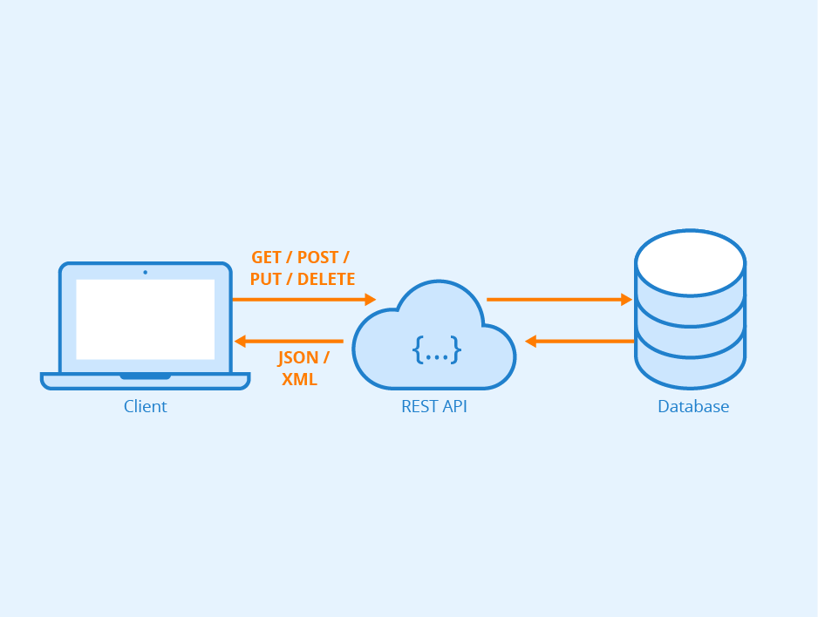
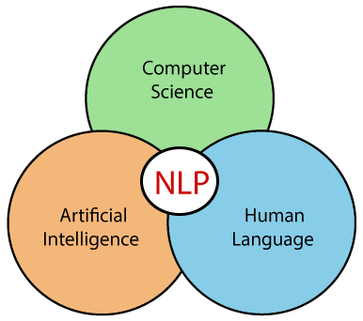
Tech stack
API :
Application Programming Interface is a set of definitions and protocols that is used for building and integrating programs.
NLP :
Field of AI that gives machines the ability to read, understand and derive meaning from human language.
It is an inter disciplinary field of computer science and linguistic using machine learning.

Slide 4
Solution Detail
Device can ask for confirming the choices.
User can make changes to choices.
Selected hotel names are displayed to user and send to his email.
User initiates the process of booking by using correct utterances.
Device understand the request and asks certain details.
Users responds to every query.
Origin
Travel date
Destination
Number of guests
Device then requests contact detail, phone number, and email to continue.
Details of payment
are sent back through API and are displayed to user.
Payment link is send to email via API.
Device may asks for conformation of booking.
User selects the hotel that fits the best.

Slide 5
Plan implementation summary
User initiates booking process by using special utterances
and respond to each and every query of the device correctly
and patiently.
Device has a built in booking management system which is activated by using correct utterances.
Device questions the user regarding the booking details like time and date , number of guests ,location etc.
It may also asks for conformation of spoken choices.
It send selected hotel names and payment link and returns the payment detail and booking ticket.
NLP
Payment Gateway
API
Payment detail generated
API

Slide 6
Future scope
Voice assistant is becoming more powerful, easier to use and able to understand context better. More people are starting to use voice search and voice assistant. It has a huge scope in field of artificial intelligence and a bright future.
Popular voice assistant that are used nowadays are:
Amazon echo:
Released in 2014, Alexa is a amazon’s cloud based voice search platform that empowers an entire smart device ecosystem.
Echo device connect to voice controlled personal assistance service called Alexa, which get activated when we say the phrase “Alexa”.
High accuracy is achieved by sophisticated Natural language processing algorithm built in the Echo’s text to speech engine.
Siri:
Released in 2011, Siri is a virtual assistant that is part of Apple Inc.'s iOS, iPad OS, watch OS, macOS, tv OS, and audio OS operating systems.It solve simple queries and perform complex task to provide information ,entertainment and general assistance.
It uses voice query, gesture based control , focus tasking, natural language user interface to answer questions, make recommendations and perform task by delegating to other services.

